Slide 1
CHAPTER 9: BUILD THE BRAND
Copyright © McGraw-Hill Education. All rights reserved. No reproduction or distribution without the prior written consent of McGraw-Hill Education.
McGraw-Hill Education
Part 3: Develop the Value Offering—The Product Experience

Slide 2
Learning Objectives
Recognize the essential elements in a brand.
Learn the importance of brand equity in product strategy.
Explain the role of packaging and labeling as critical brand elements.
Define the responsibility of warranties and service agreements in building consumer confidence.

Slide 3
Brand: The Fundamental Character of a Product
A brand is “a name, term, sign, symbol, or design, or any feature that identifies one seller’s goods or services as distinct from those of other sellers.”
~American Marketing Association

Slide 4
Brands Play Many Roles: Branding Strategy
Branding strategy is an integral part of the product development process because companies know that successful new products result from a well conceived branding strategy.
Notes:
Whether the customer is a consumer or another business, brands have three primary roles. First, the brand conveys information about the product. Without any additional data, customers construct expectations about quality, service, even features based on the brand.
Brands also educate the customer about the product. People assign meaning to their product experiences by brand and, over time, make judgments about which brands are best at meeting their needs and which are not. As a result, product evaluations and purchase decisions become less formidable as the customer relies on the cumulative brand experience to simplify the purchase process.
A third brand role is to help reassure the customer in the purchase decision.

Slide 5
Brands Play Many Roles: Customer Brand Roles
Customer Brand Roles
Brands convey information about the product.
Brands educate the customer about the product.
Brands help reassure the customer in the purchase decision.

Slide 6
Brands Play Many Roles: Company
Company Brand Roles
Brands offer legal protection for the product through a trademark.
Brands offer an effective and efficient methodology for categorizing products.

Slide 7
Brands Play Many Roles: Competitor
Competitor Brand Roles
Market-leading brands provide competitors with a benchmark against which to compete. For example, Huawei and LG compare their smartphones to brands like Samsung and Apple to get noticed.

Slide 8
The Boundaries of Branding
A good branding strategy will not overcome a poorly designed product that fails to deliver on the value proposition.
Counterfeit products or illegal activities conducted under the name of another company’s brand can do significant damage to the brand.
There must be real, identifiable and meaningful differences among products in the market space and to create a brand identity.

Slide 9
Defining Brand Equity
Defining Brand Equity
A set of assets (and liabilities) linked to a brand’s name and symbol that adds to (or subtracts from) the value provided by a product or service to a firm or that firm’s customers.

Slide 10
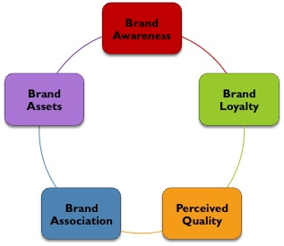
Brand Equity: Owning a Brand
Defining Brand Equity
Notes:
Brand awareness: The most basic form of brand equity is simply being aware of the brand. Awareness is the foundation of all other brand relationships. It signals a familiarity and potential commitment to the brand.
Brand loyalty: This is the strongest form of brand equity and reflects a commitment to repeat purchases. Loyal customers are reassured by the brand and are often ambassadors to new customers. Loyal customers enable a company to reduce marketing costs, leverage trade relationships, and speak to competitive threats with greater success.
Perceived quality: Brands convey a perception of quality that is either positive or negative. Companies use a positive perceived quality to differentiate the product and create higher price points. Rolex watches have been able to sustain a price premium long into their life cycle because of the perceived quality in design and performance of the product.
Brand association: Customers develop a number of emotional, psychological, and performance associations with a brand. In many cases, these associations become a primary purchase driver, particularly with brand loyal users. Dell has a reputation as a mass-market computer company with reasonably good-quality products but poor customer service. As a result, competitors, such as Hewlett-Packard, have been able to create market opportunities by associating their brand with higher levels of product support and customer service.
Brand assets: Brands possess other assets such as trademarks and patents that represent a significant competitive advantage. Google is very protective of its search algorithm intellectual property, which, in the view of the company, gives the company a significant advantage over other search engines.

Slide 11
World’s Most Valuable Brands
EXHIBIT 9.3
Brand | Category | Brand Value (2016, $Mil.) | Brand Contribution | Brand Value % Change (2015-2016) | Rank Change
1. Google | Technology | 229,198 | 4 | 32% | 1
2. Apple | Technology | 228,460 | 4 | -8% | -1
3. Microsoft | Technology | 121,824 | 3 | 5% | 0
4. AT&T | Telecom | 107,387 | 3 | 20% | 2
5. Facebook | Technology | 102,551 | 4 | 44% | 7
6. Visa | Payments | 100,800 | 4 | 10% | -1
7. Amazon | Retail | 98,988 | 3 | 59% | 7
8. Verizon | Telecom | 93,220 | 3 | 8% | -1
9. McDonald’s | Fast Food | 88,654 | 4 | 9% | 0
10. IBM | Technology | 86,206 | 4 | -8% | -6
Source: Business Week, August 6, 2007, http://bwnt.businessweek.com/interactive_reports/top_brands/

Slide 12
Brand Equity: Customers, Sponsors, and Benefits
 | Perceived Quality | Brand Connections | Brand Loyalty
Customers | Gives them a reason to buy. | Customers seek information on familiar brands. Strong brands generate positive attitude. | Brand loyal customers spend less time in the purchase decision.
Brand Sponsor | Extend the product range. Price premium. Differentiates in the marketplace. | Strong brands create a barrier for competitor’s new brand. | Reduces marketing costs. Gives channel leverage. Word-of-mouth. Forgiving customers.
Linking Strategy to Benefit | Build quality into the entire customer experience. | Extend the brand to new products. | Marketers have more flexible budgets.

Slide 13
Branding Decisions: Stand Alone or Family
Stand-alone or family branding
Stand-alone brands separate the company from the brand which insulates the company if there is a problem with the brand but are expensive and offer little or no synergy between company brands (e.g., Unilever personal care products: AXE, Dove, Lifebuoy, Lux, Pond’s, Rexona, Sunsilk, Vaseline).
Family branding advantages and disadvantages are just the opposite. One negative event reflects on all (e.g., Heinz ketchup and other condiments).
Notes:
It is interesting to note that Lever Brothers stand alone branding allows it to offer competing messages. Dove’s Real Beauty campaign champions everyday women while AXE branding has been criticized as hyper-sexualized.

Slide 14
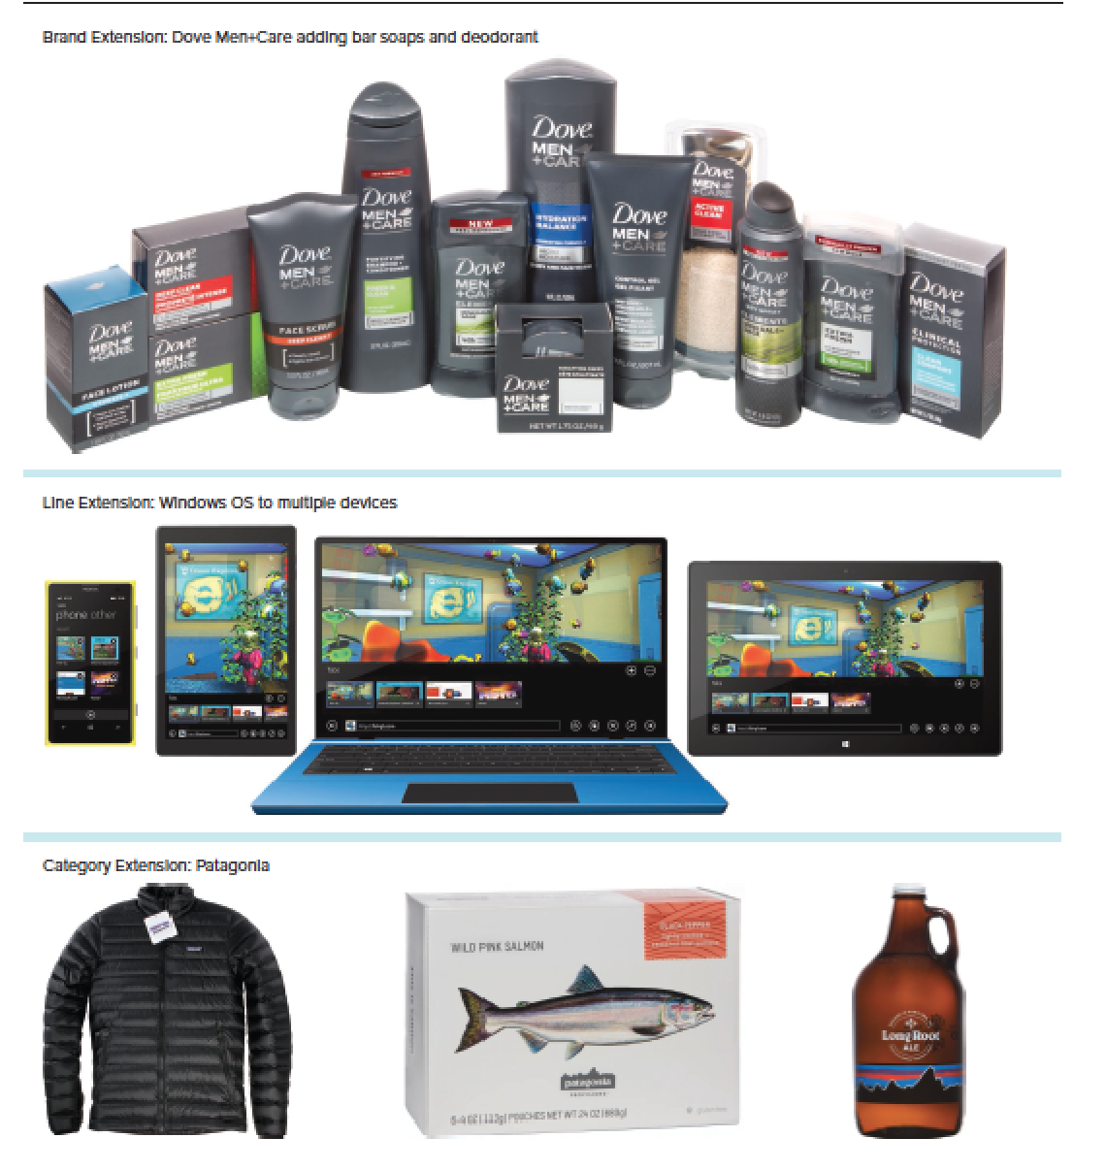
Brand, Line, and Category Extensions
Sources: (Dove Men+ Care and Patagonia): Editorial Image, LLC; and (Windows OS): Microsoft.

Slide 15
Branding Decisions: National or Store
National or Store Branding
National brands that are sold around the country under the same brand.
Create efficiencies in marketing communications and distribution
Higher perceived quality and price
Store brands are when large retailers create a store brand to market their own products.
Stores contract with national manufacturers like P&G and compete with national brands through lower prices.

Slide 16
Branding Decisions: Licensing
Licensing
Companies can also choose to extend their brand by licensing, offering other manufacturers the right to use the brand in exchange for a set fee or percentage of sales.
Little risk.
Generates additional revenue.
Extends the brand and builds brand associations with new users.
Must be monitored closely for product quality and brand image protection.

Slide 17
Branding Decisions: Co-Branding
Co-Branding
Co-branding joins two or more well known brands in a common product or takes two brands and markets them in partnership (e.g., soft drinks and Splenda; Intel Inside logo).

Slide 18
Co-Branding
Advantages | Disadvantages
Strength of each brand supports the other. | Loss of control.
Opens up new markets. | Negative effect if one brand has problems.
Lowers marketing communication costs. | Overexposure.

Slide 19
Branding Decisions: Co-Branding Relationships
Co-Branding Relationships
Joint venture: like Visa or American Express affinity cards.
Two internal brands are linked like P&G’s Scope and Crest.
Multiple companies join to create a new brand like Marriott Hotels and Ikea creating a new European hotel brand for Millennials.

Slide 20
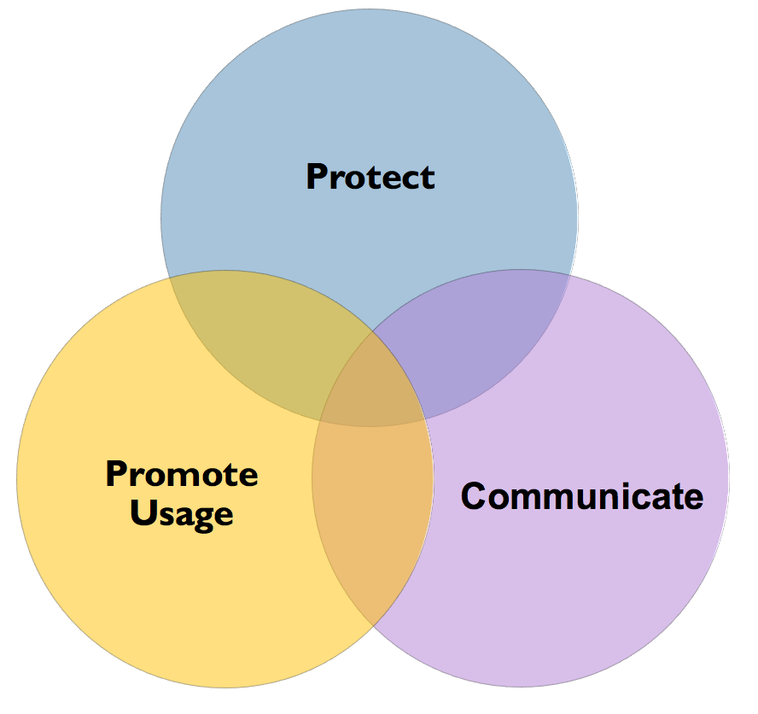
Essential Brand Elements: Packaging
Package Objectives
Notes:
Protect Above all, the package must protect the product. The challenge is defining how much protection is necessary and cost-effective. In some cases, as in a can of Coke, the package is a significant component of the product’s overall cost so there is concern about any increases in package cost. However, the can of Coke must be strong enough to hold the carbonated beverage under variations in temperature and other use conditions. Additionally, Coca-Cola must consider a variety of package materials (plastic, metal), sizes, and shapes (regular can, Coke’s classic “contour” design), and it must design each to operate more or less the same under a variety of situations
Protecting customers from unauthorized access to the product is also part of package design. Prescription bottles and most over-the-counter medicines are required to be tamper-proof and child-proof to protect customers. Finally, a growing concern is product theft, particularly in the retail store. As a result, the package design should include anti-theft methodology, such as bar coding or magnetic stripes, that discourages shoplifting.
Communicate Packages communicate a great deal of information about the product. Some of that information is designed as marketing communications. At the point of sale, the package is the last marketing communication the customer will see before the purchase. Consequently, packaging plays a critical role in the company’s overall marketing communications strategy, particularly for consumer products. Unique package design can create a distinctive competitive advantage. Coke’s contour bottle is an important component of the overall brand image for those product.
Promote Usage Package design also encourages product use. It does this in several ways. First, packages frequently show the product being used by a happy customer. Second, in many cases, packages visually demonstrate a product. Third, marketers and package designers make extensive use of blister packs (products encased in clear plastic) and other package designs to visibly present and protect the product.

Slide 21
Packaging and Labeling: Essential Brand Elements
Effective Packaging
Aesthetics:
Color plays a significant role in package design and in the entire branding strategy.
Designs that are appropriate, interesting, and persuasive to the target market are critical.
Harmonizes with all elements of marketing mix:
The package reinforces marketing communications by connecting advertising images (logo, pictures on the package) to the customer.

Slide 22
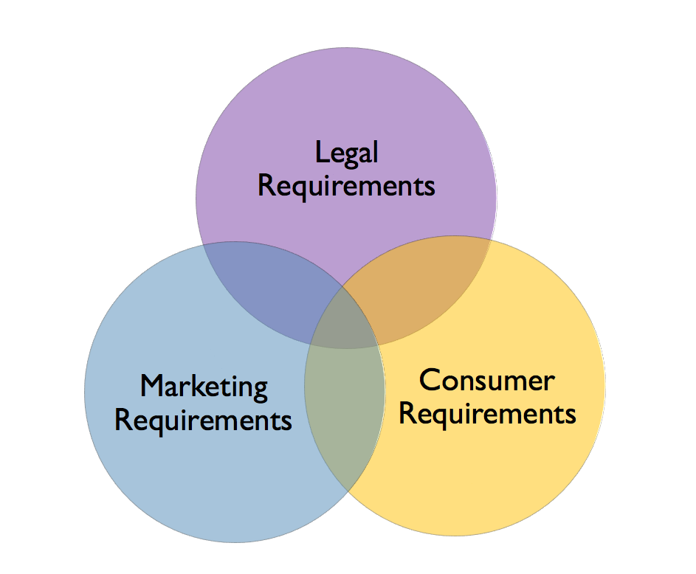
Essential Brand Elements: Labeling
Labeling
Notes:
Legal Requirements Labels must meet federal, state, even local rules and regulations. The Food and Drug Administration (FDA) requires all processed-food companies to provide detailed nutritional information clearly identifying calories, fats, carbohydrates, and other information. Other products must have warnings of a certain size that are easily read and understood by the customer.
Consumer Requirements Consumers want to use products out of the box and package labeling is the most convenient place for initial use instructions. Additionally, product precautions, simple assembly information, and appropriate age for product use may also be included on the package.
Marketing Requirements Since package labeling represents the last marketing opportunity before the purchase decision, as much label space as possible is allocated to marketing communications. Brand, logo, product image, and other relevant marketing messages take up the dominant space on the label.

Slide 23
Types of Warranties: Building Customer Confidence
General warranties make broad promises about product performance and customer satisfaction.
Allows customers to return for a variety of reasons.
Specific warranties offer explicit product performance promises related to components of the product.
Auto warranties are specific like for engines, drive trains, or tires.

Slide 24
Warranties and Service Agreements: Building Customer Confidence
Warranties help define the brand.
Cost versus benefit.
Must be competitive within the industry.
Hyundai uses warranty to build confidence in Korean cars.
Conveys a message to the customer about perceived quality and manufacturer commitment to customer satisfaction.
Especially with expensive products, warranties can help in the final purchase decision.

